Slide 1
Nano Satellite
By:
S. Hrithik Sriram
K.Amsath Khan

Slide 2
Nano Satellite :
Overview
Understanding the problems
Project objective
Block Diagram
Working
Uses in Various Domains

Slide 3
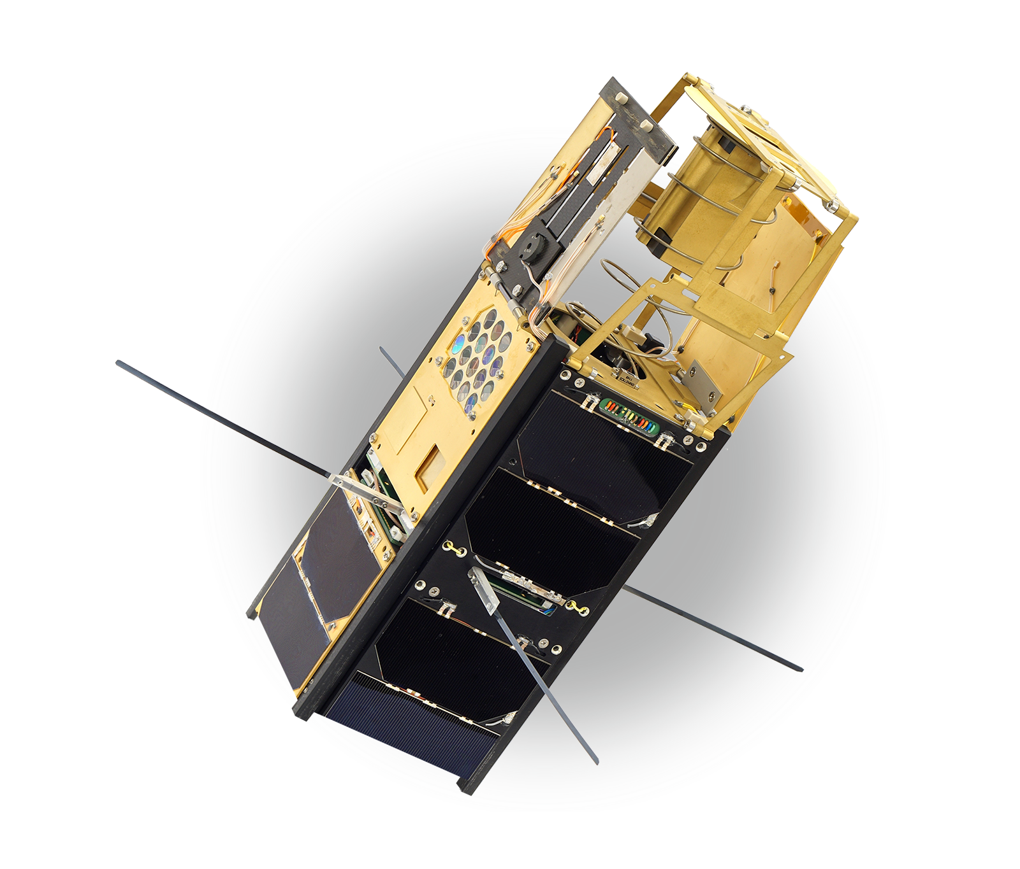
Overview
A Nano satellite, miniaturized satellite, or cubesat is a satellite of low mass and size, usually under 50 kg . While all such satellites can be referred to as "Nano", different classifications are used to categorize them based on mass. Satellites can be built small to reduce the large economic cost of launch vehicles and the costs associated with construction. Miniature satellites, especially in large numbers, may be more useful than fewer, larger ones for some purposes – for example, gathering of scientific data and radio relay. Technical challenges in the construction of small satellites may include the lack of sufficient power storage or of room for a propulsion system.

Slide 4
Understanding the problems
01
ORBIT INSERTION COST IS HIGHER, DUE TO THE WEIGHT CAPACITY (usually Ranges From 1 ton upto 10 tons ).
02
VERY HIGH COST FOR MANUFACTURING AND DESIGNING OF THESE SATELLITES
03
IT IS VERY DIFFICULT TO REPLACE ANY DAMAGED PARTS BEACAUSE THE REPAIR IN SPACE COSTS MUCH HIGHER THAN THE DAMAGED PAYLOAD

Slide 5
Project objective
We Made an Nanosatellite Just Weighing Only 450 grams in weight. And it hosts a variety of sensors such as an Ozone sensor, Linear Magnetic Flux Density Sensor , and an onboard IMU(inertial Measurement Unit). This can be used to find the level of ozone concentration in the upper Atmosphere and to detect the magnetic flux density around the planet . This Contains an Onboard ESP8266 Microcontroller , Which Manages and Controls Every Aspect of the Satellite From collecting Telemetry data and Relying them back to the ground station , Power Management and Solar Panel Direction.

Slide 6
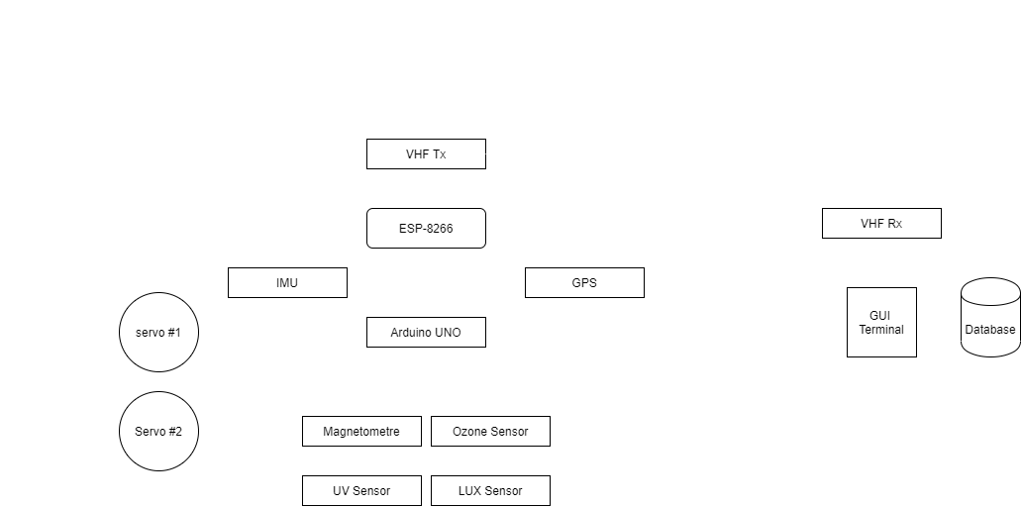
Block Diagram :

Slide 7
Advantages:
The Launch and Orbit Insertion Cost are Much Lower than the Traditional Satellite Because of the Reduced Size and Weight .
As it Orbits in the LEO (lower earth orbit ). Various Important Parameters of Our Earth Can be Monitored with simple Sensory Components.
The Power Consumption of these Nano Satellites are Very low and they usually ranges between 10 and 50 mA .which means it can survive upto 2 months with its onboard battery even if the solar panel is somehow damaged.
The Cost of Designing and Fabricating a NanoSatellite is very very less Compared to an Traditional normal Satellite

Slide 8
Application in Various Domains
Weather forecasting and monitoring :
Lot of Nanosatellites combined together to form an weather monitoring cluster which will cover more surface area and so the prediction model will be more precise than traditional satellite
Telecommunication :
These Cluster can be used to rely data from one place to another , thus effectively acting as an replacement for internet relay.
Ex : Starlink Satellite constellation developed by SpaceX.

Slide 9
Thank you!

